Slide 1
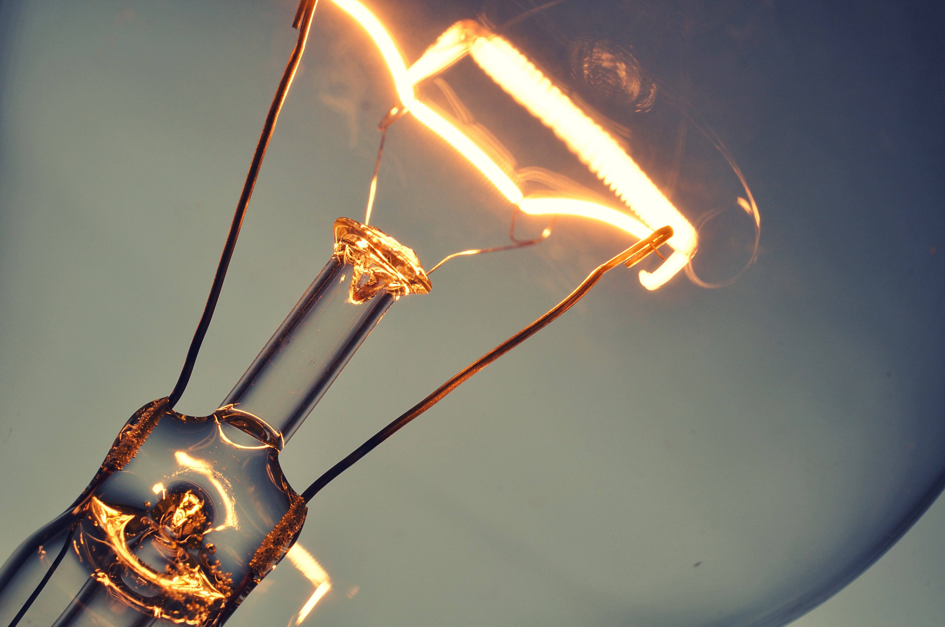
Welcome to class!
When you are not in class, who are the top three people you spend the most time with?
Type your answer in the chat window

Slide 2
Attention Activity: “Connections Quiz”
Name the three wealthiest people in the world
Name the last three Heisman Trophy winners
Name the last three winners of the Miss America contest.
Name three people that have won the Nobel Prize.
Name the last three Academy Award winners for best actor.
Name the last five world series winners.

Slide 3
Connections Activity continued…
List three teachers, counselors, or school staff who have helped you in school.
Name three true friends that you can count on.
Name three people who have taught you something worthwhile.
Name three people who have made you feel appreciated and special.
Who are three people you enjoy spending time with?
List three people who really care about you.

Slide 4
Processing the Experience
Was it easier to answer the first set of questions or the last set of questions? Why?
Who has a more lasting impact on our lives: the people who would be in the first set of questions or the last set of questions? Why?
Which of the people from the second set of questions has had the biggest impact on your life? Why?
How can we find more people like those people to help us in life?
How can we be this type of person for others?
How can plugging in help us achieve our goals?

Slide 11
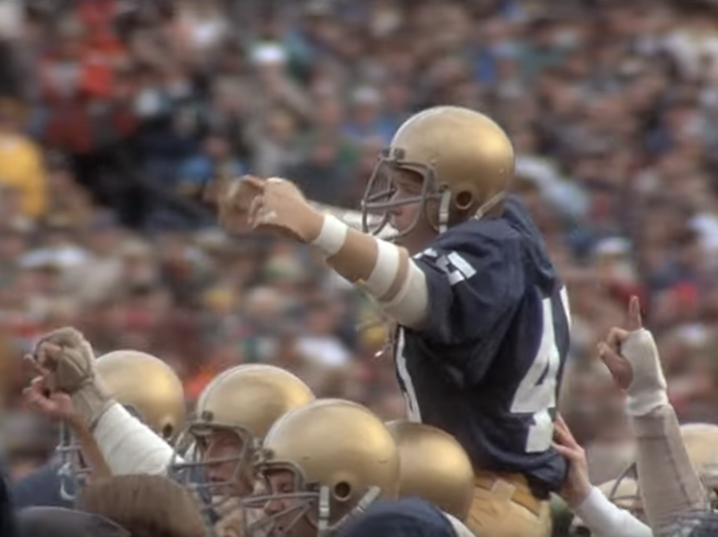
Video Clip
https://www.youtube.com/watch?v=ZI63g64kDgY

Slide 12
Journal Activity
Think of someone you really like. List 5 qualities that person has that make you like them.

Slide 13
Game Plan Activity
Identify a list of people you want to connect with to help you accomplish your goals.
Take time to make contact with these people and tell them about your goal.

Slide 14
Art Activity
Make a drawing or collage or get a photo that represents the people who have made a difference in your life.

