Slide 1
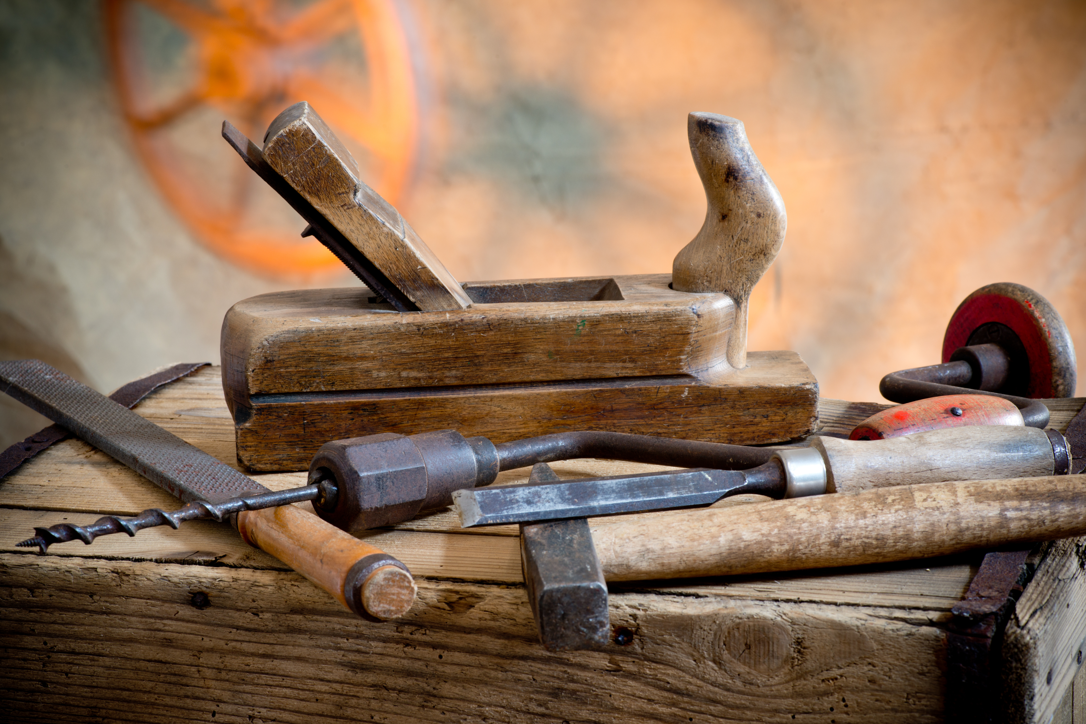
Welcome To Class!
Question of the day:
What is your favorite rollercoaster or amusement park ride that you have been on and why?
Type your response in the chat window!

Slide 2
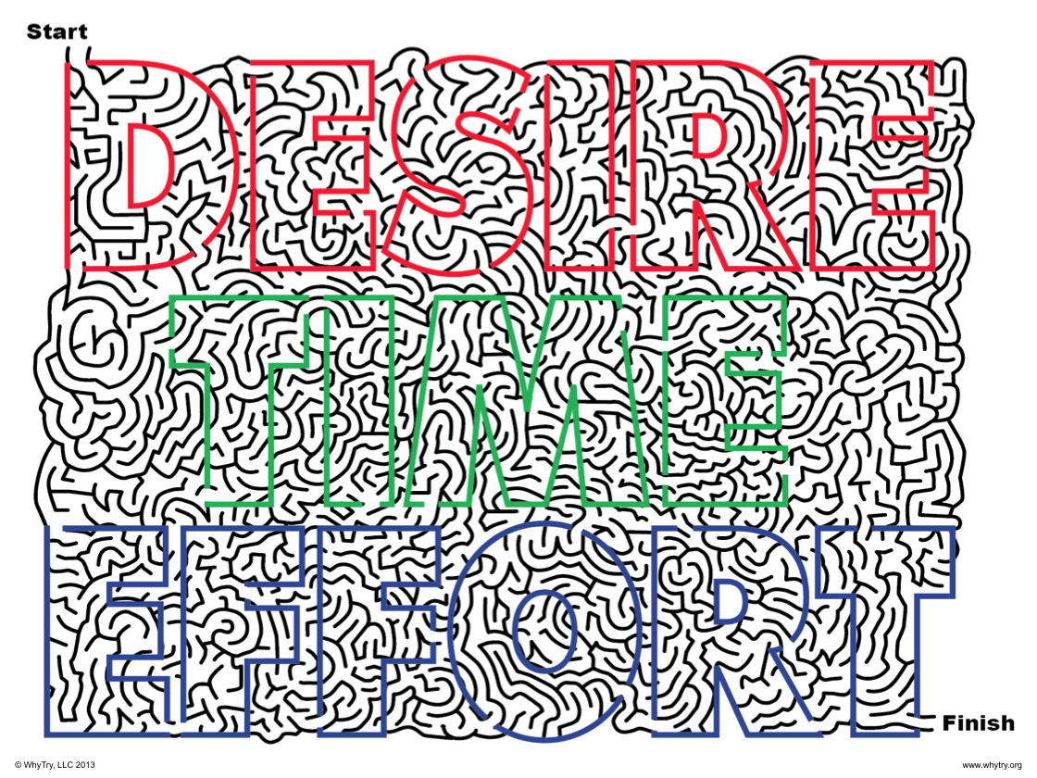

Slide 3
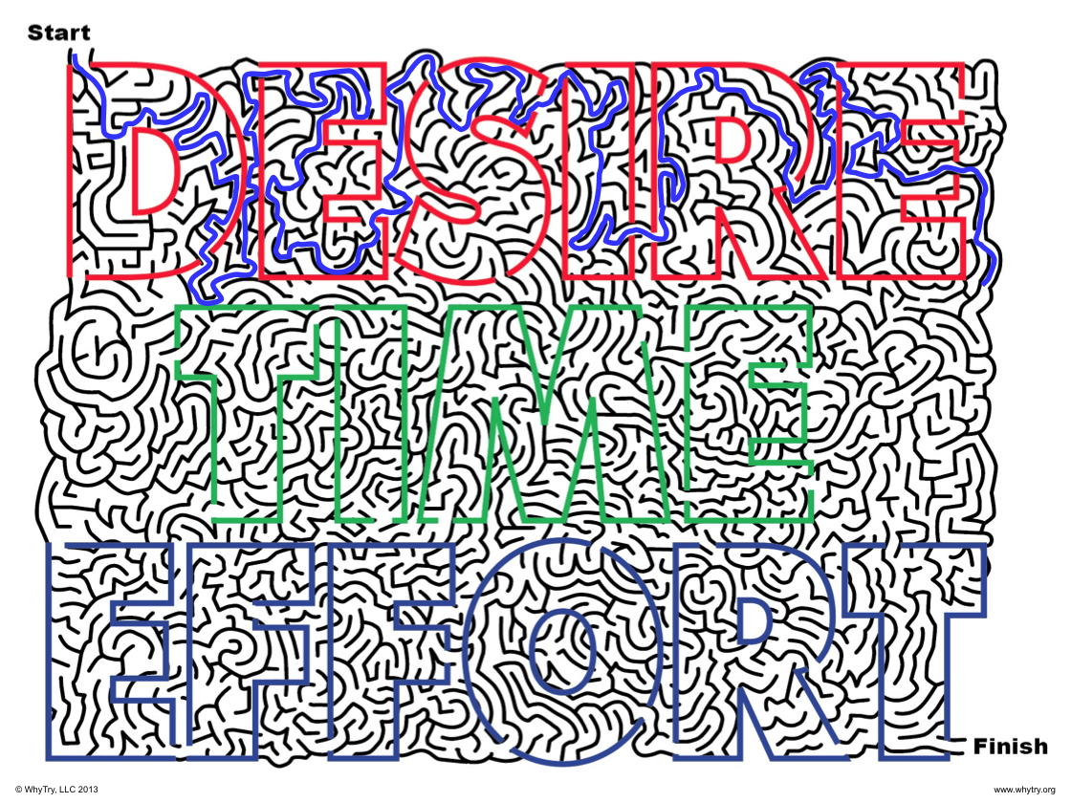

Slide 4
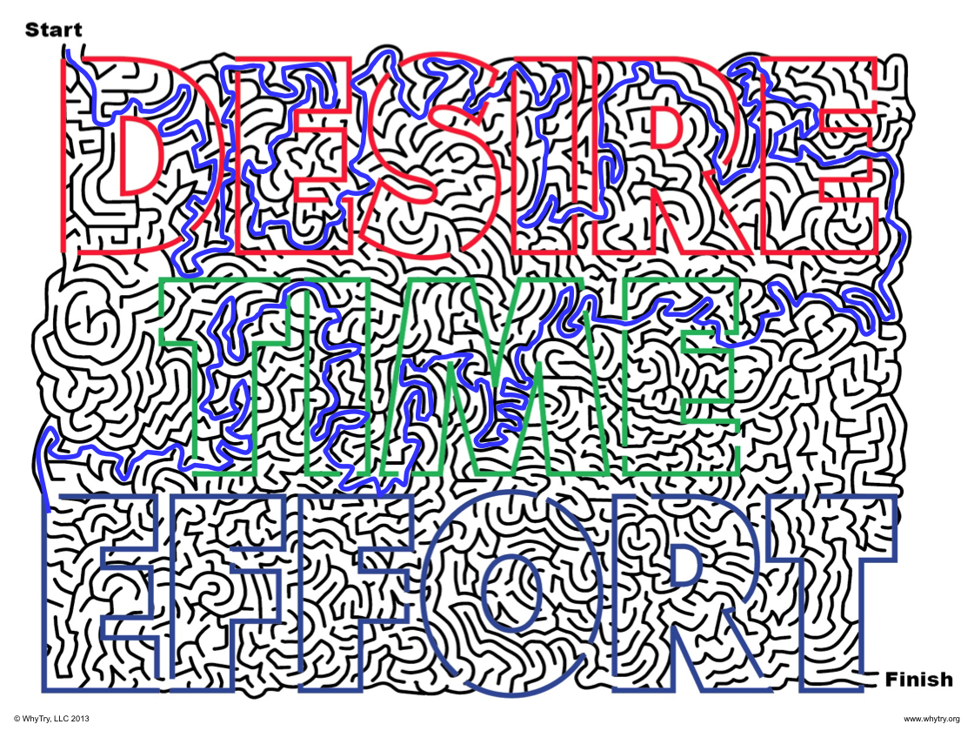

Slide 5
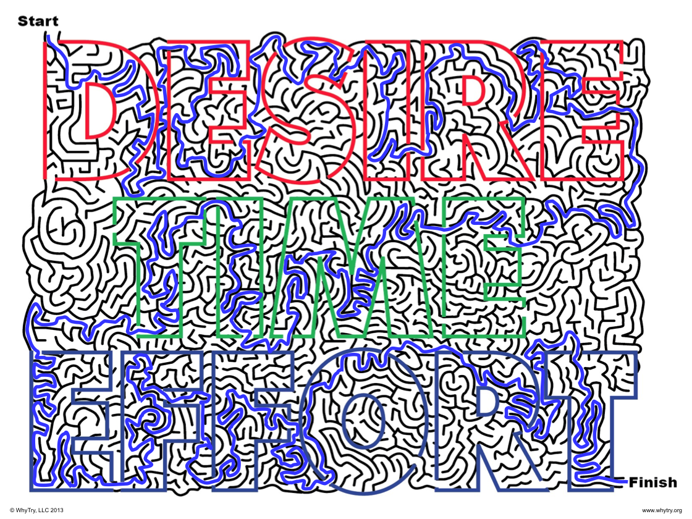

Slide 6
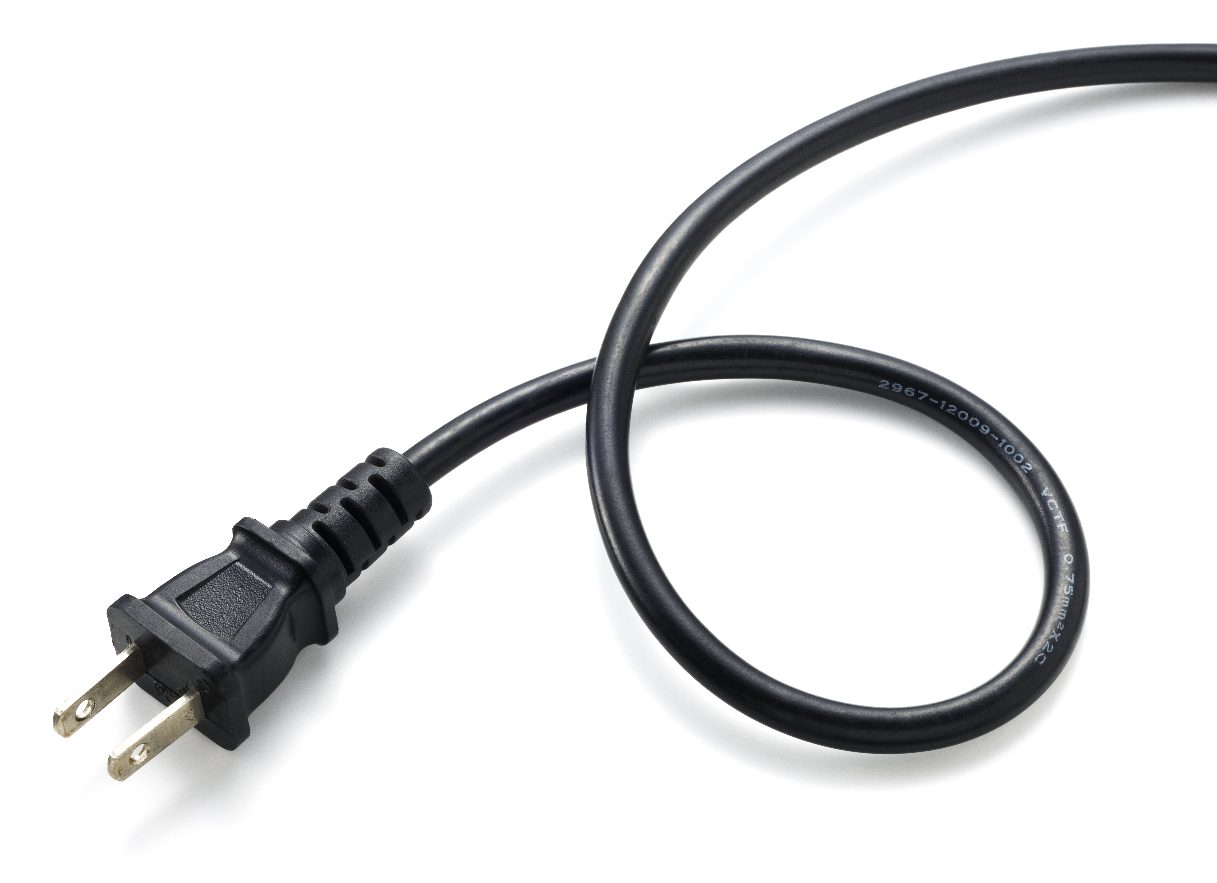
Plugging in Activity
Share a copy of the maze with a family member and have them complete the maze on a paper (if you can print it) or just have them trace the path on your screen with their finger or something like back of a pen. Tell them that you will be timing them to see how long it takes.
When they get close to finishing, take the paper (or screen) away from them and watch how they react! Explain their reaction in writing

Slide 7
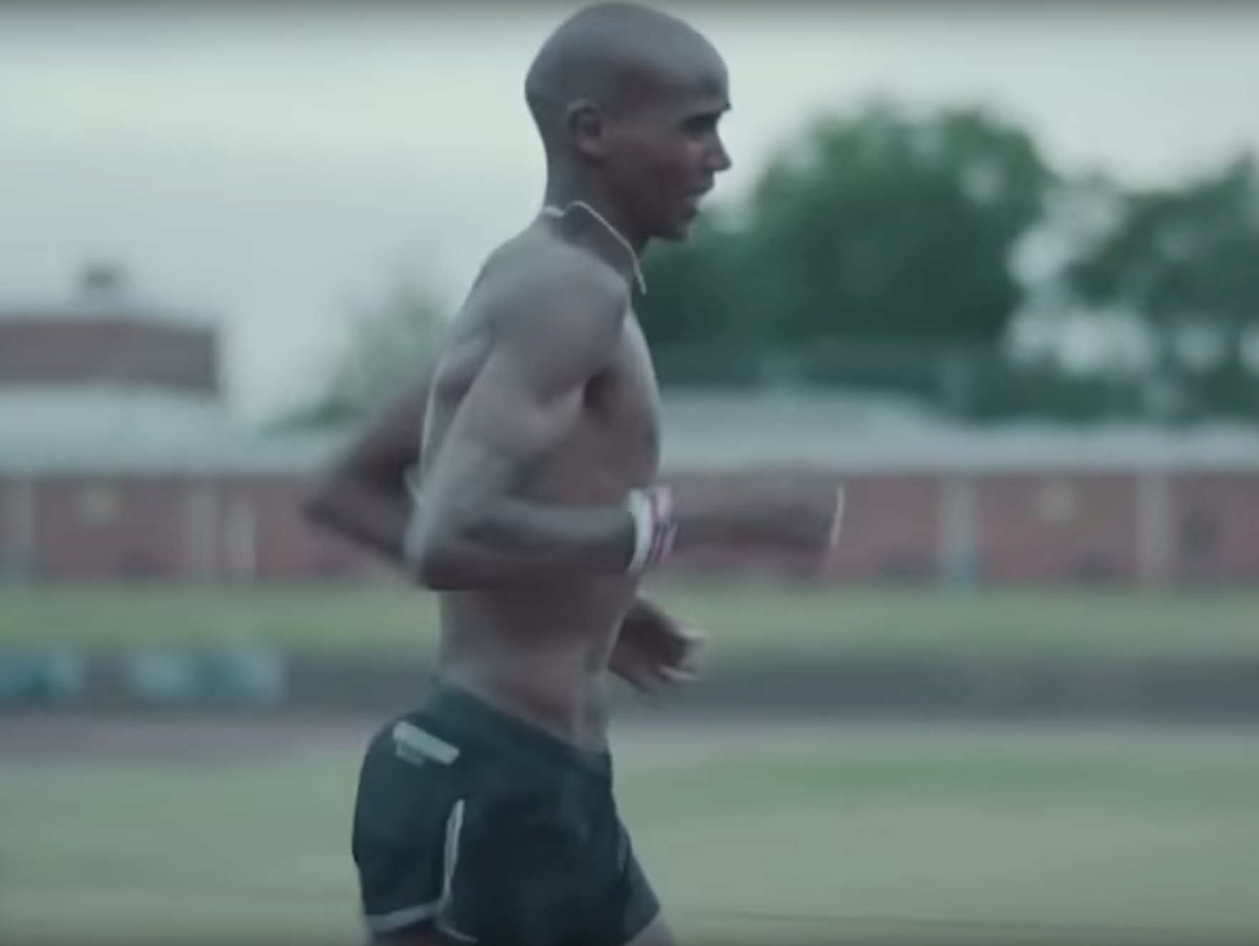
Video Clip.
Here is a video of a great athlete training and putting in desire, time and effort toward something. Watch for examples of all three in this video:
https://www.youtube.com/watch?v=n8aAaGDNosQ

Slide 8
Video Clip.
Questions:
What are you putting your time and effort into?

Slide 9
Video Clip.
Questions:
What are you putting your time and effort into?
What is the payoff when we put effort into something?

Slide 10
Video Clip.
Questions:
What are you putting your time and effort into?
What is the payoff when we put effort into something?
How can we increase the effort we put into the things that are important?

Slide 11

Journal Activity
Identify something you have accomplished:
How did you feel when you accomplished it?
How can that feeling help you accomplish more?
Did you ever feel like giving up...?
How did you push through those feelings of wanting to give up?
What is something you want to accomplish in the future?
How will Desire, Time, & Effort help you accomplish it?

Slide 12
Art Activity
Your Personal Watch:
Many people wear a wrist watch in order to help manage their time wisely. Often watches reflect an individual’s taste and personality.
Design your dream watch, one that reflects something you would like to accomplish with your time.

