Slide 1
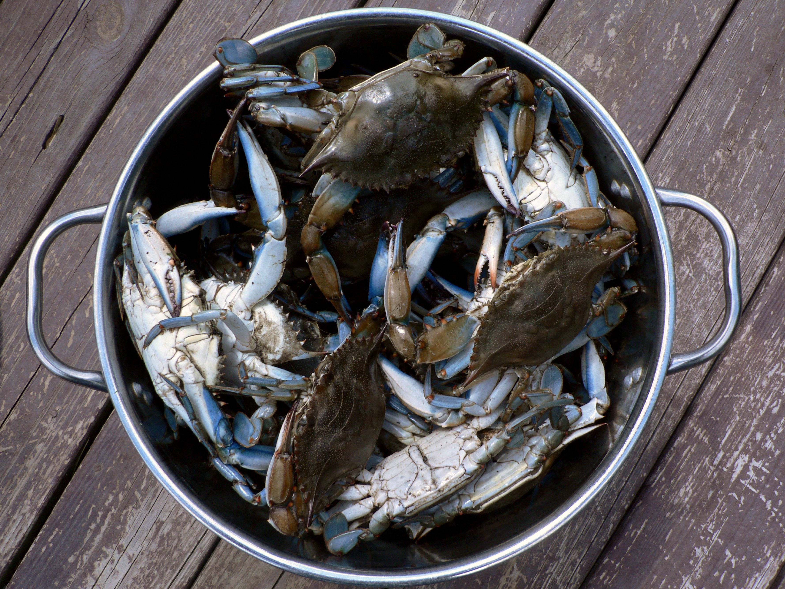
Welcome To Class!
Question of the day:
Make a list of all your friends. Write down one word next to each name that best describes that person.
Type your response in the chat window!

Slide 2
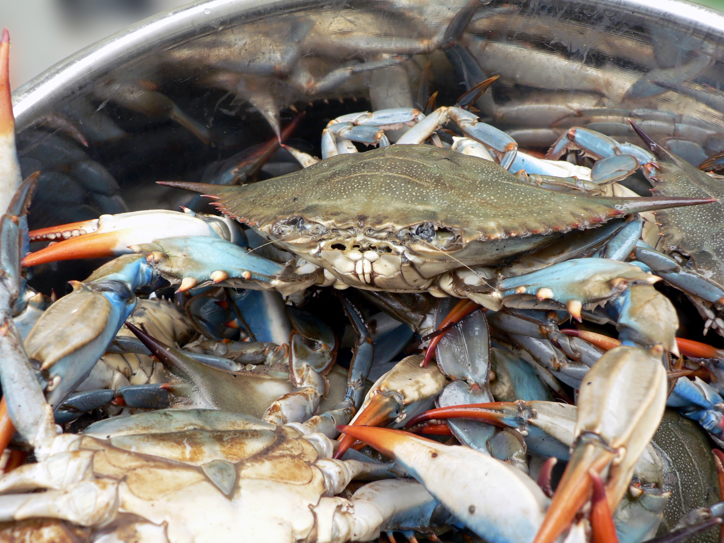
Video Clip!
https://youtu.be/D1F6IYh6Xhs

Slide 3
Video Clip!
Questions:
Why was it hard for that crab to get out of the pot?

Slide 4
Video Clip!
Questions:
Why was it hard for that crab to get out of the pot?
What kind of “pots” do we have in our lives?

Slide 5
Video Clip!
Questions:
Why was it hard for that crab to get out of the pot?
What kind of “pots” do we have in our lives?
Do we usually try to keep people in or help out of their pots? How?

Slide 15
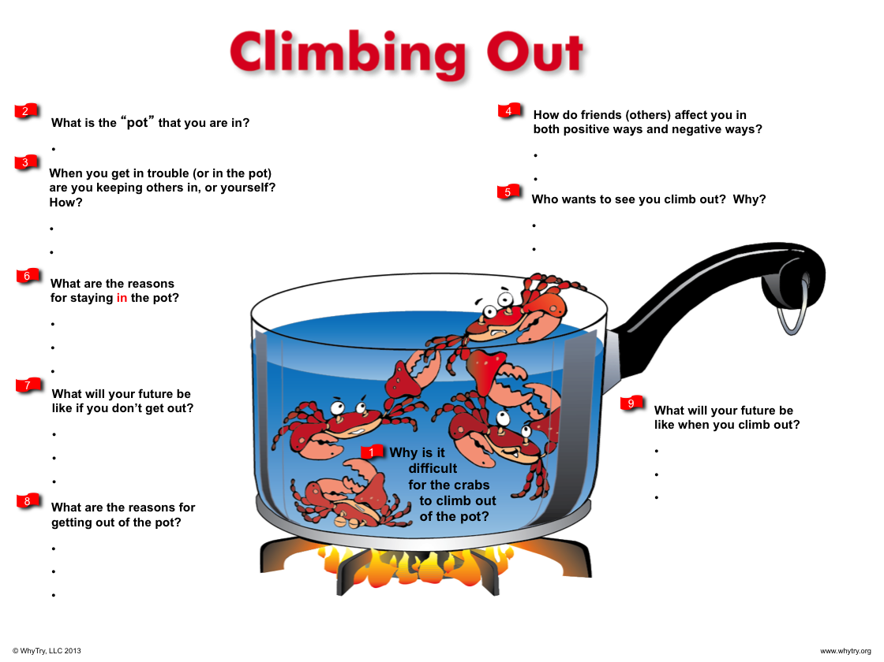

Slide 16
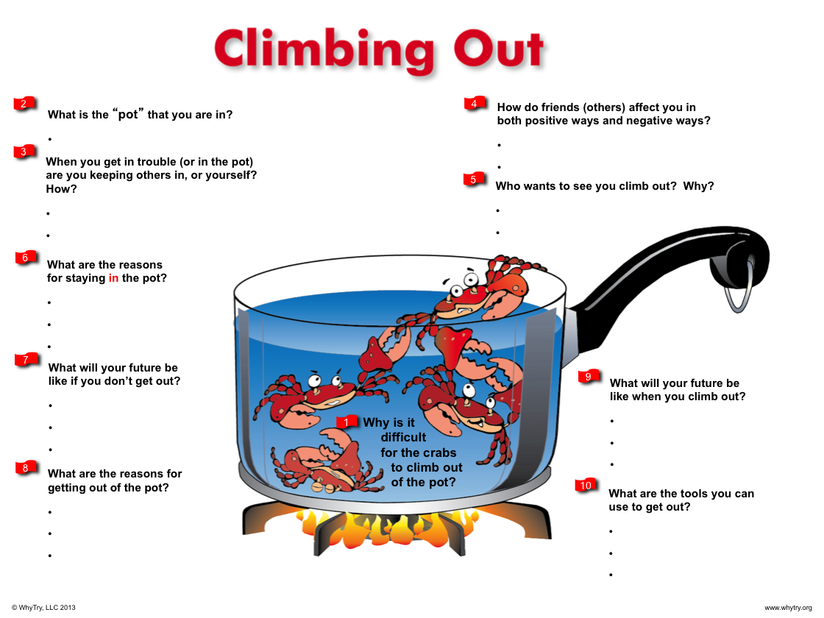

Slide 18
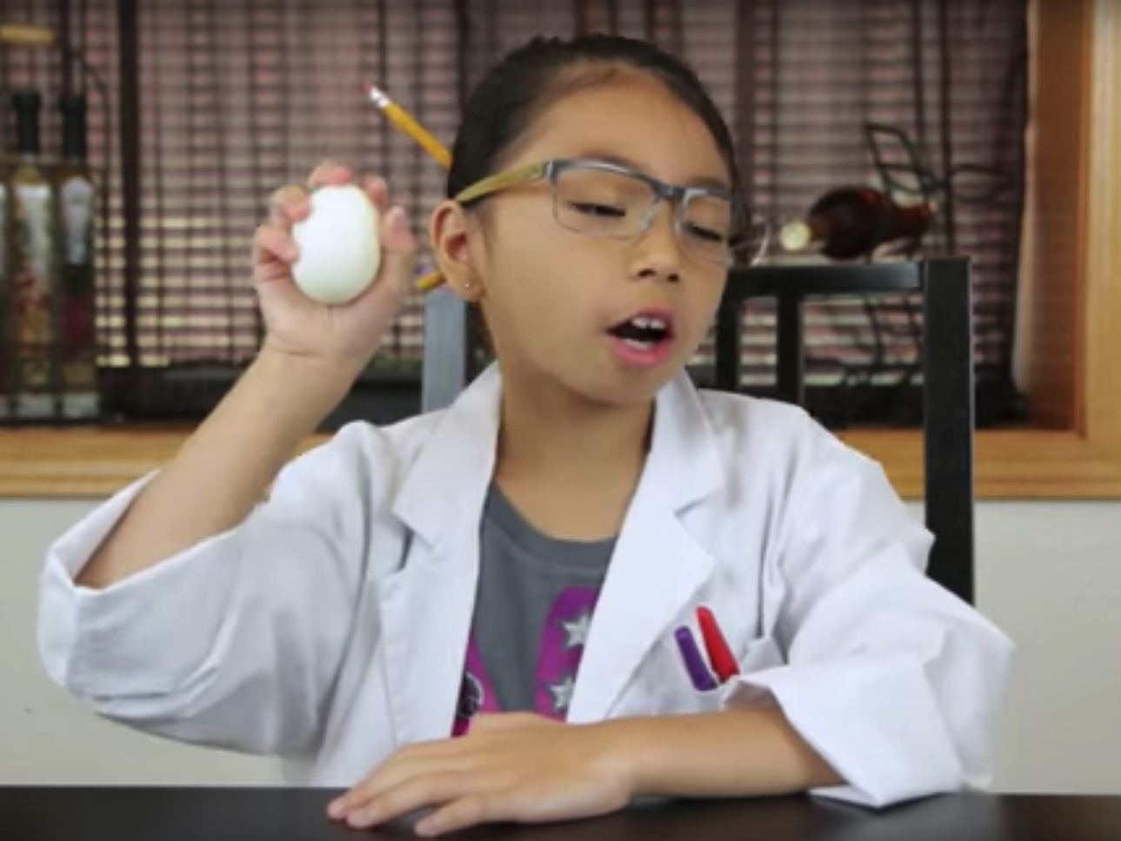
Video Clip!
https://www.youtube.com/watch?v=tmc9U_mK3v4&t=2s

Slide 19
Video Clip!
Why do you think the egg went into the bottle when the flame was used?

Slide 20
Video Clip!
Why do you think the egg went into the bottle when the flame was used?
How is this activity like peer pressure?

Slide 21
Video Clip!
Why do you think the egg went into the bottle when the flame was used?
How is this activity like peer pressure?
What is an example of a situation where it is difficult to say no?

Slide 22
Video Clip!
Why do you think the egg went into the bottle when the flame was used?
How is this activity like peer pressure?
What is an example of a situation where it is difficult to say no?
Are we more susceptible to peer pressure by being in the wrong place at the wrong time? How?

Slide 23
Video Clip!
Why do you think the egg went into the bottle when the flame was used?
How is this activity like peer pressure?
What is an example of a situation where it is difficult to say no?
Are we more susceptible to peer pressure by being in the wrong place at the wrong time? How?
Is it harder to say no the longer you are in a situation? Why?

Slide 24
Video Clip!
Why do you think the egg went into the bottle when the flame was used?
How is this activity like peer pressure?
What is an example of a situation where it is difficult to say no?
Are we more susceptible to peer pressure by being in the wrong place at the wrong time? How?
Is it harder to say no the longer you are in a situation? Why?
What can you do to help yourself resist the pressure to do something that might be harmful to you?

Slide 25
Video Clip!
Why do you think the egg went into the bottle when the flame was used?
How is this activity like peer pressure?
What is an example of a situation where it is difficult to say no?
Are we more susceptible to peer pressure by being in the wrong place at the wrong time? How?
Is it harder to say no the longer you are in a situation? Why?
What can you do to help yourself resist the pressure to do something that might be harmful to you?
How do you get out of negative peer pressure?

Slide 26
Journal Activity
Use five words to complete the phrase: A good friend is _________
Do any of these words also describe you?
What words would you use to describe a false friend?
How would you describe your friends?

Slide 27
Plugging in Activity
Make a list of friends that have helped you out in the past. In what ways did they help you?
Pick on of your friends and write them a thank you note, card, text, or email.

