Slide 1
Welcome To Class!
Question of the day:
What is your favorite activity that involves water?
Type your response in the chat window!

Slide 2
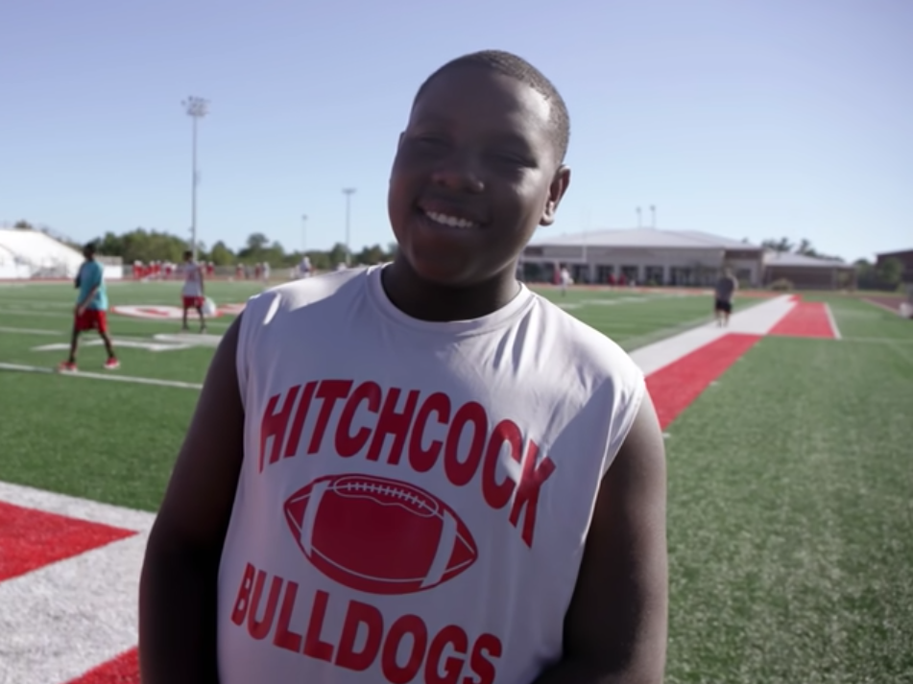
Video Clip!
https://www.youtube.com/watch?v=7y8HjalvoaM

Slide 3
Processing the clip:
What challenge did Virgil and others face in this video?

Slide 4
Processing the clip:
What challenge did Virgil and others face in this video?
How did Virgil overcome the challenge?

Slide 5
Processing the clip:
What challenge did Virgil and others face in this video?
How did Virgil overcome the challenge?
Why didn’t he give up?

Slide 6
Processing the clip:
What challenge did Virgil and others face in this video?
How did Virgil overcome the challenge?
Why didn’t he give up?
How did he help others with the challenges they were facing?

Slide 7
Processing the clip:
What challenge did Virgil and others face in this video?
How did Virgil overcome the challenge?
Why didn’t he give up?
How did he help others with the challenges they were facing?
What can we learn about this for our own lives?

Slide 19
Story: Butterfly Story
http://www.hawaiiswim.org/business/TheButterfly/TheButterfly.html

Slide 20
Create your own creed or motto
Art Assignment
You can use any art medium to do this (colored pencils, photos, pictures from internet or magazines, etc). It should represent something positive you want to become or achieve. It can be something to tell yourself (positive self-talk) when things are getting intense. Remember you can't control everything that happens; only what you do about it.
Put your creed or motto somewhere you will see it every day (locker room, mirror, etc)

Slide 21
Journal Activity
Write about a time when you used positive self-talk to get through a challenge.
How did it help?

Slide 22
Plugging in Activity
Ask a parent, guardian or someone you know what is the biggest challenge they have overcome in their life. Ask them how they overcame that challenge.
Try and identify their strategies and compare them to the four strategies we learn through the Motivation Formula of (positive self-talk, character and heart, passions & interests, support systems).

