Slide 1
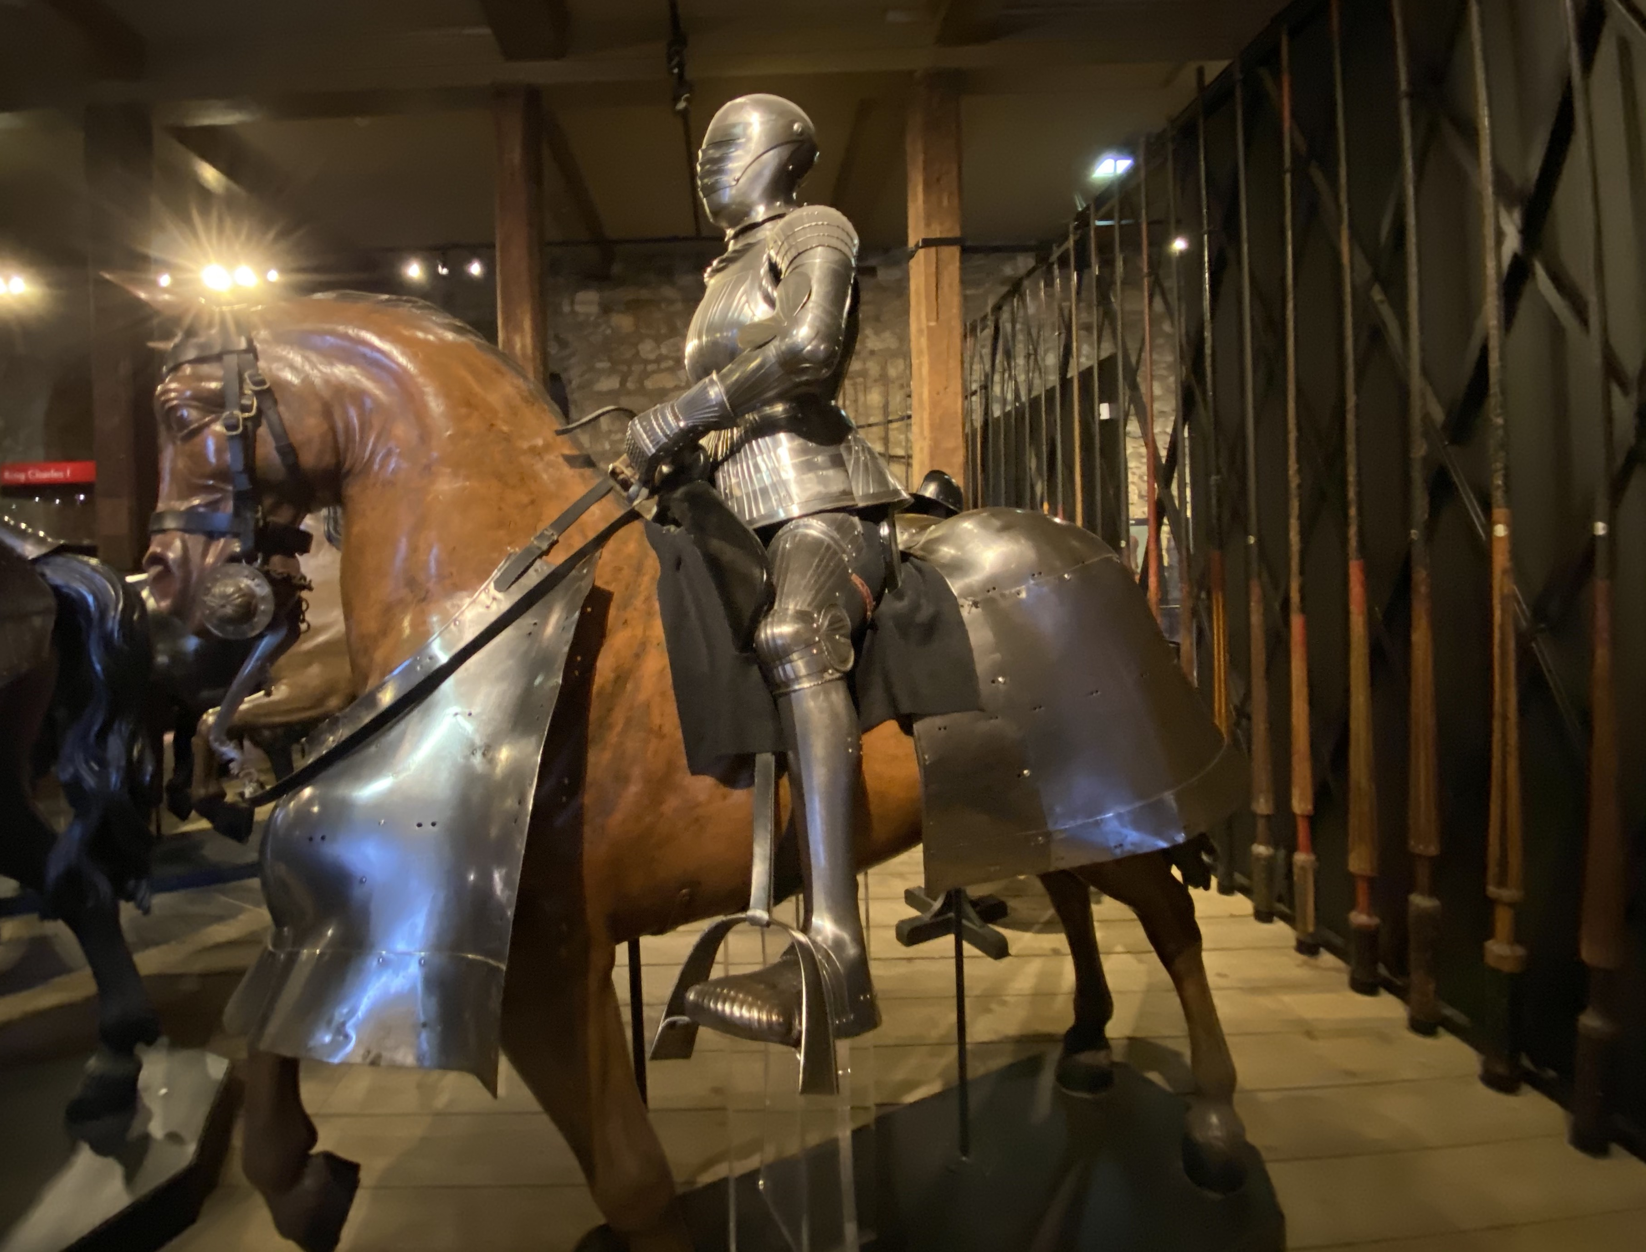
Welcome To Class!
Question of the Day:
What is the most intense movie you have ever seen that had you feeling anxious, scared, nervous or something like that?
Type your response in the chat window!

Slide 2
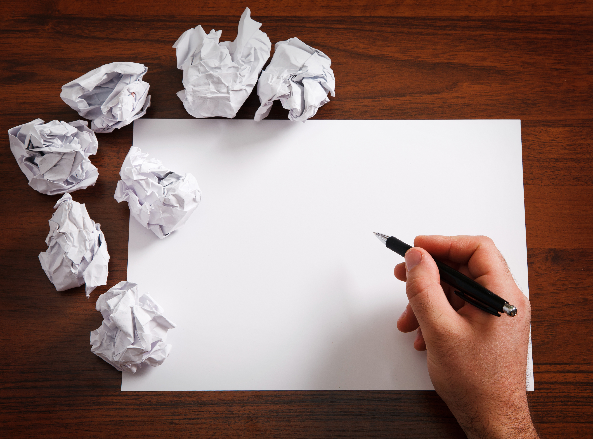
How many times can you write your name in 30 seconds?

Slide 9
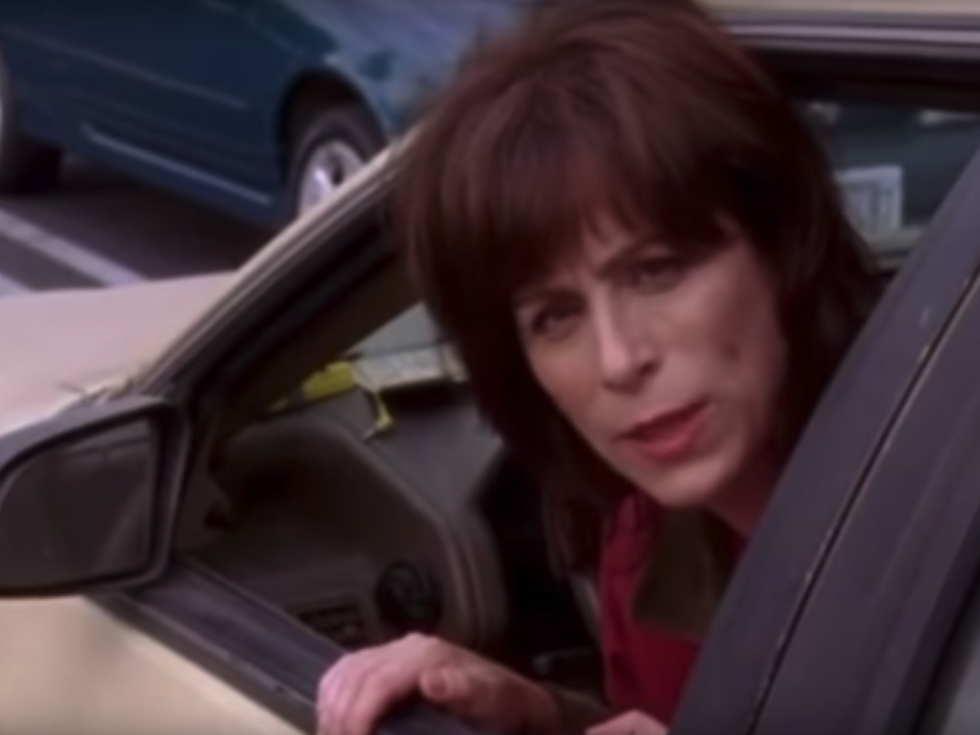
Video Clip
https://www.youtube.com/watch?v=OqqKEgrPhHo

Slide 10
Video Clip
Questions:
Who was in control of their defense mechanisms?

Slide 11
Video Clip
Questions:
Who was in control of their defense mechanisms?
What was the result of not keeping their defense mechanisms under control?

Slide 12
Video Clip
Questions:
Who was in control of their defense mechanisms?
What was the result of not keeping their defense mechanisms under control?
How can not controlling our defense mechanisms get us in trouble?

Slide 15
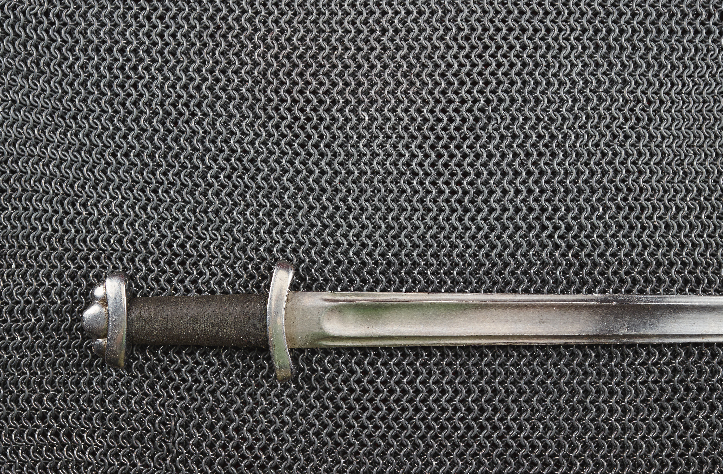
Challenge
Notice how you respond in pressure situations. Is your response more often positive or negative?
Notice how well you are able to maintain control of your defense mechanisms. If you can, identify situations where you struggle controlling your defense mechanisms.

Slide 16
Art Activity
Draw a picture that represents a positive Defense Mechanism that you have recently used in a pressure situation.

Slide 17
Journal Activity
Make a list of at least three situations this week where you used defense mechanisms.
Write down how you responded and whether it was negative or positive.

Slide 18
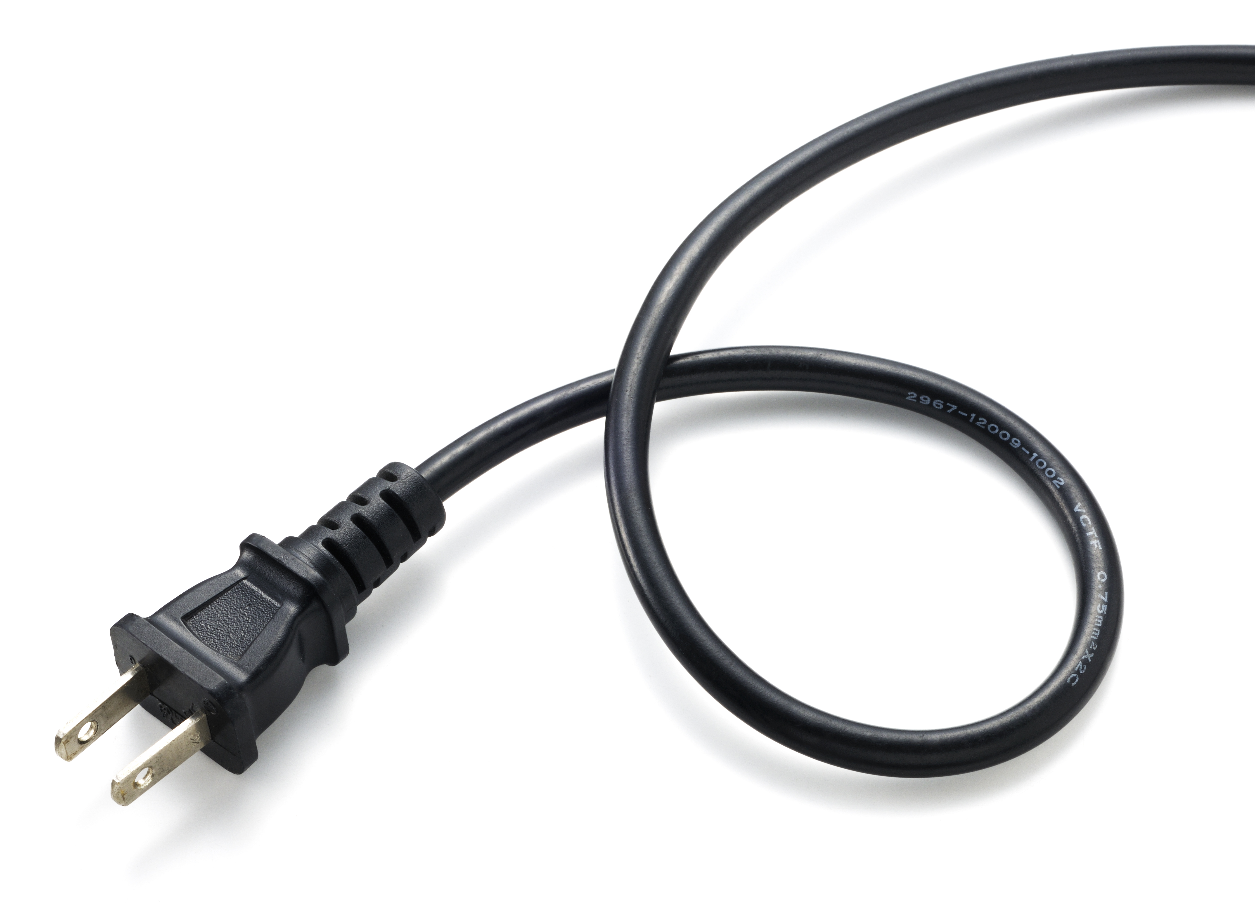
Plugging in Activity
Talk to a parent, guardian or older sibling about defense mechanisms. Explain to them the metaphor of the armor.
Ask them how they respond when they feel they are being attacked.
Ask them the following question: Why is it important to learn to control how you react in pressure situations?

