Slide 1
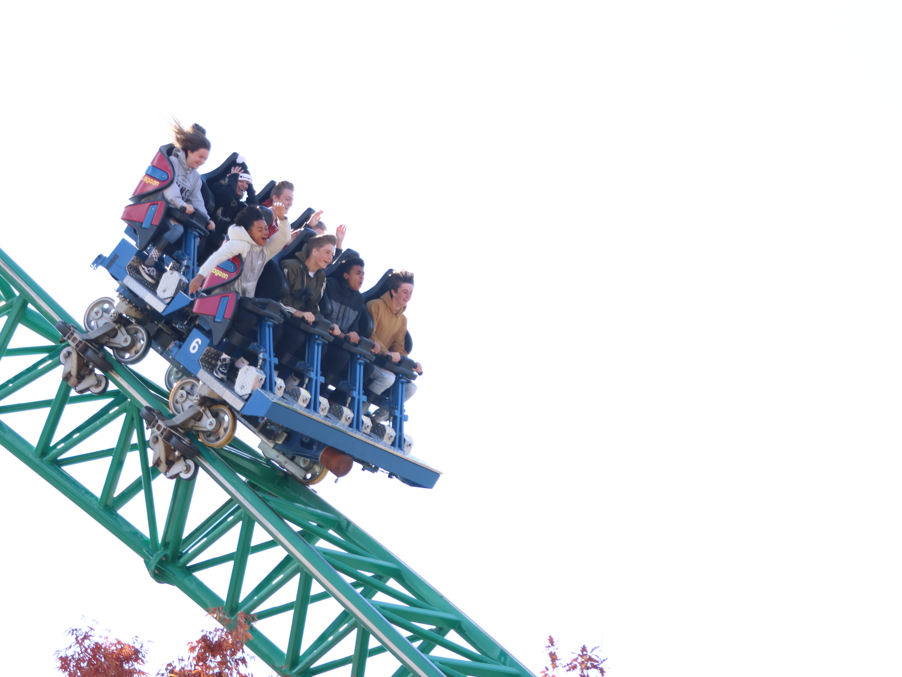
Welcome To Class!
Question of the day:
What is your favorite rollercoaster or amusement park ride that you have been on and why?
Type your response in the chat window!

Slide 2
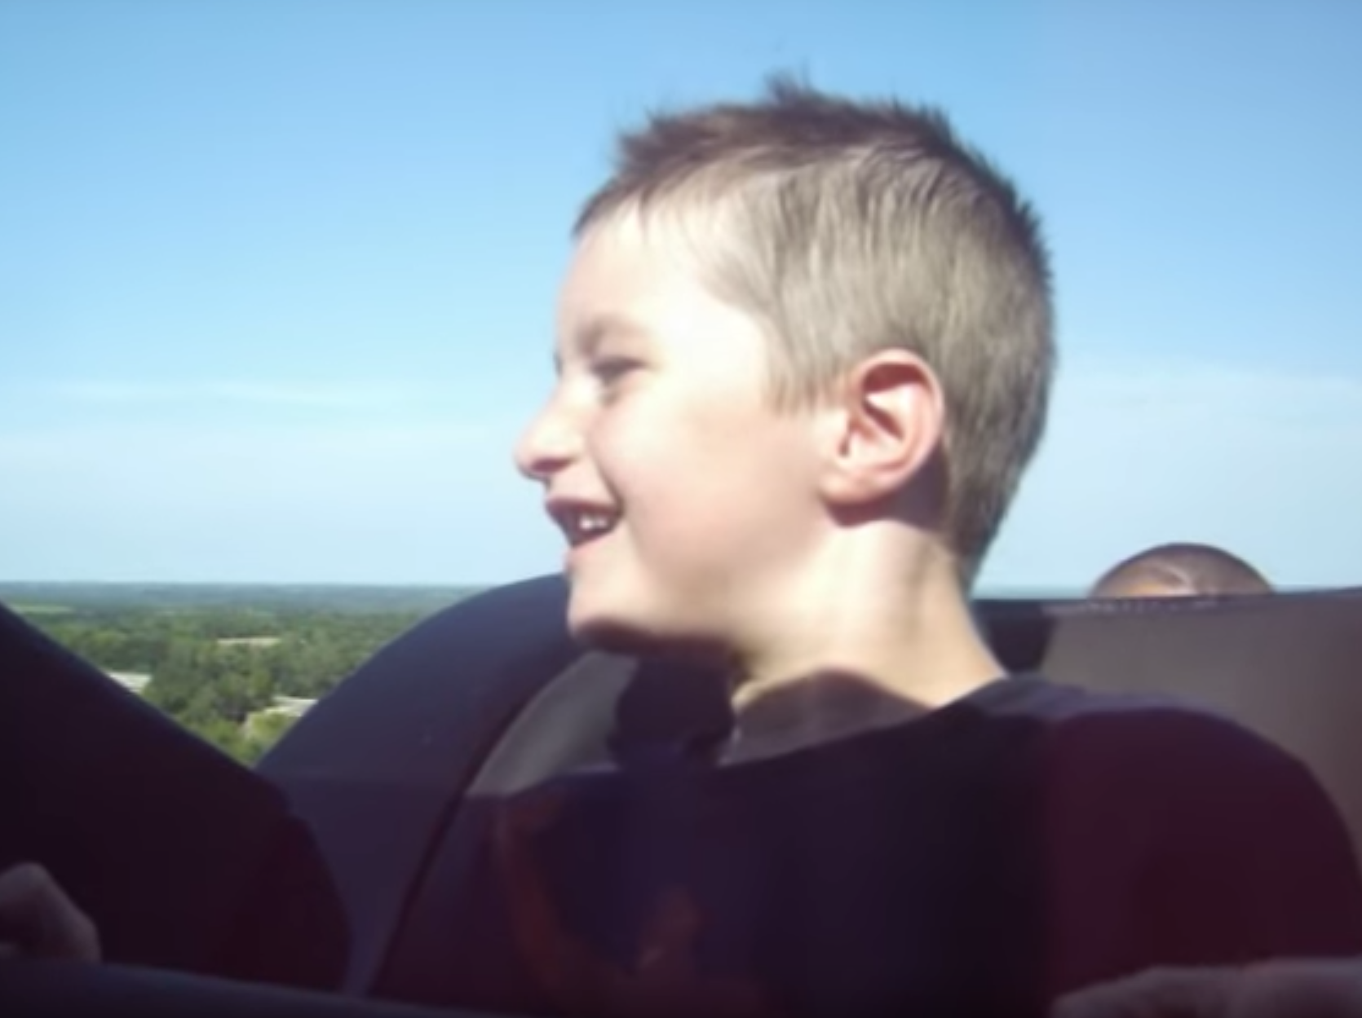
Video Clip!
https://www.youtube.com/watch?v=8XQzQYFYfy8&t=1s

Slide 3
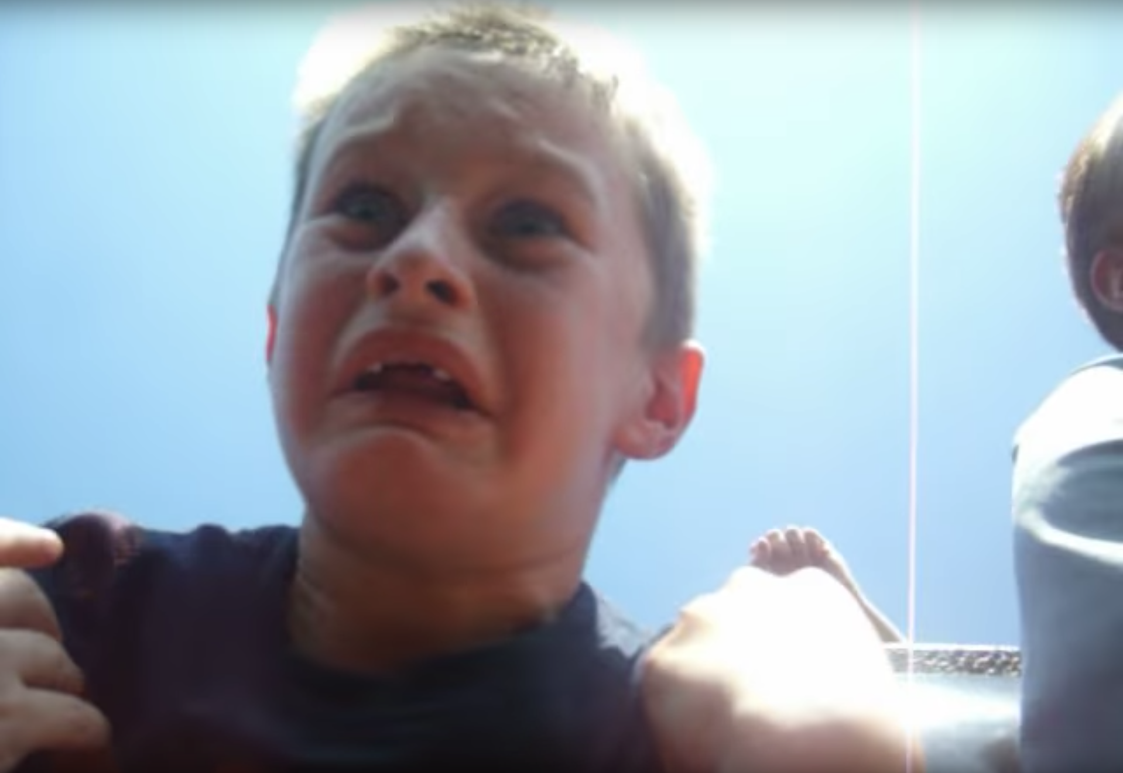
Why Do We Ride Roller Coasters?

Slide 4
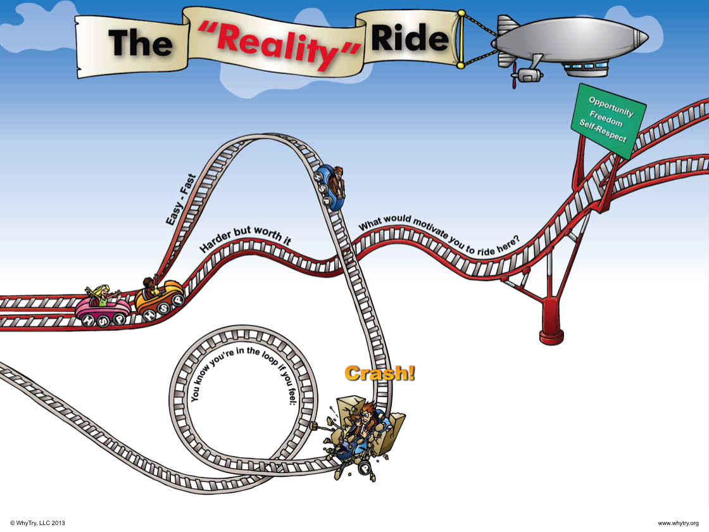

Slide 5
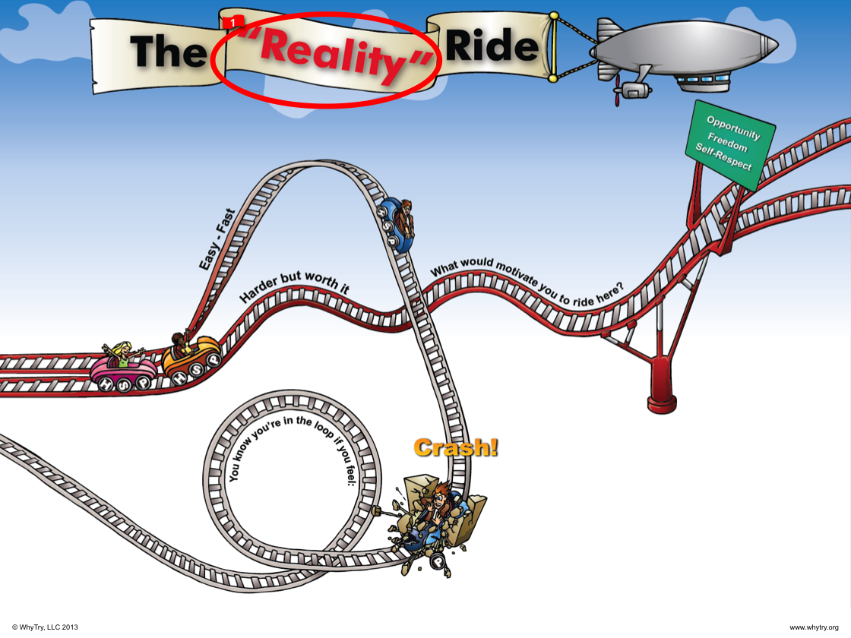

Slide 6
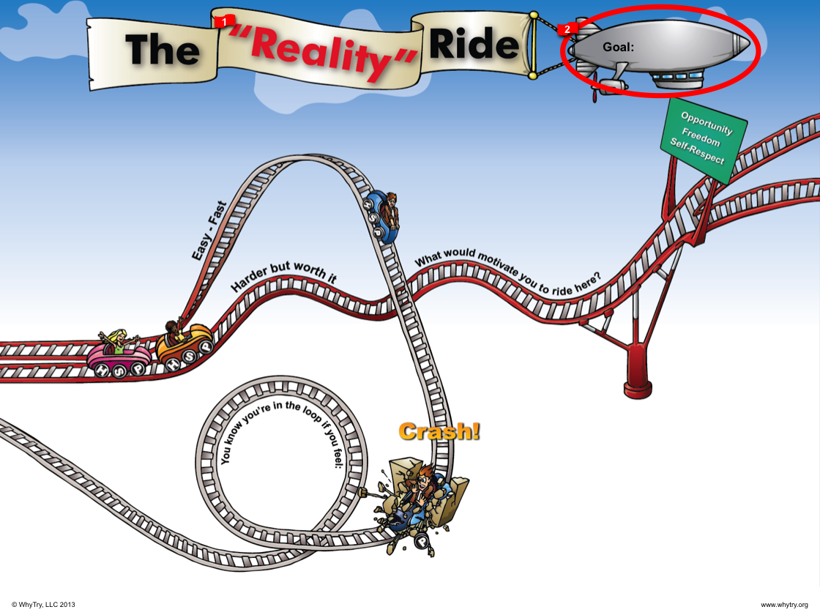

Slide 7


Slide 8
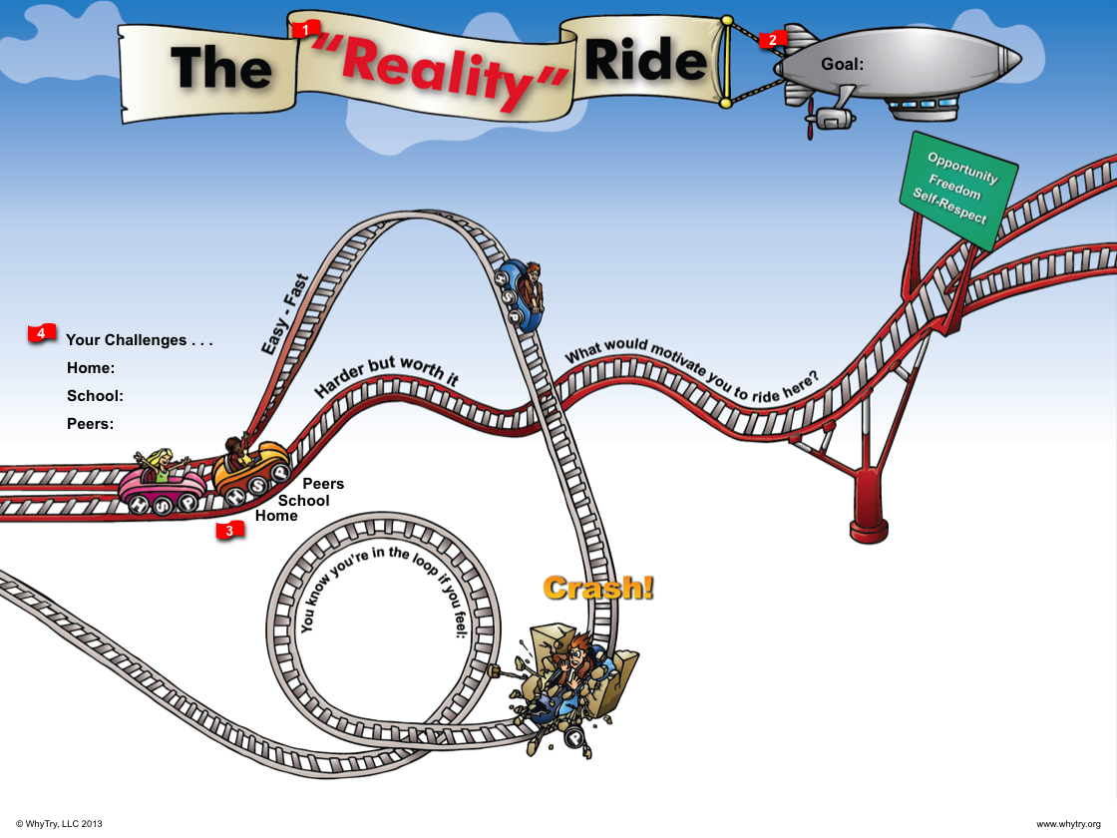

Slide 9


Slide 10
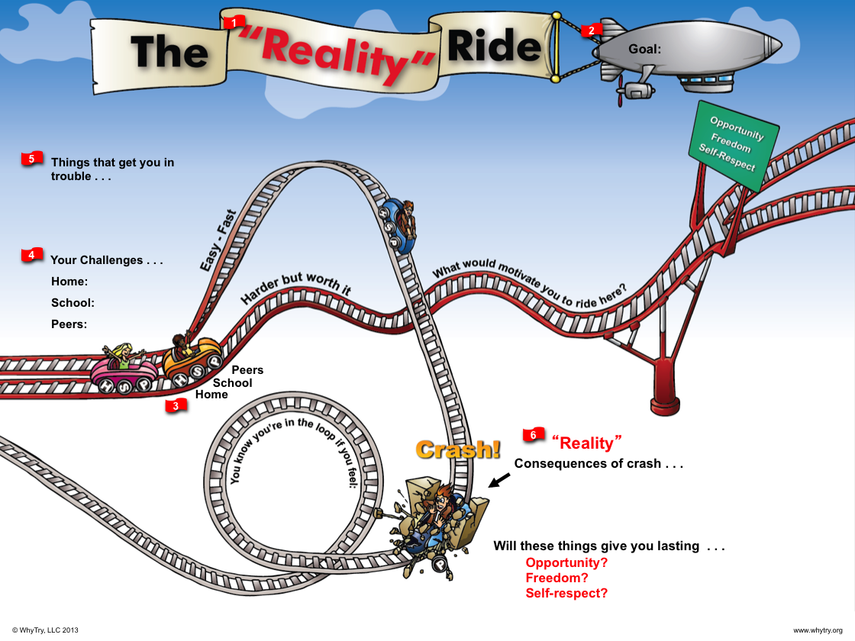

Slide 11
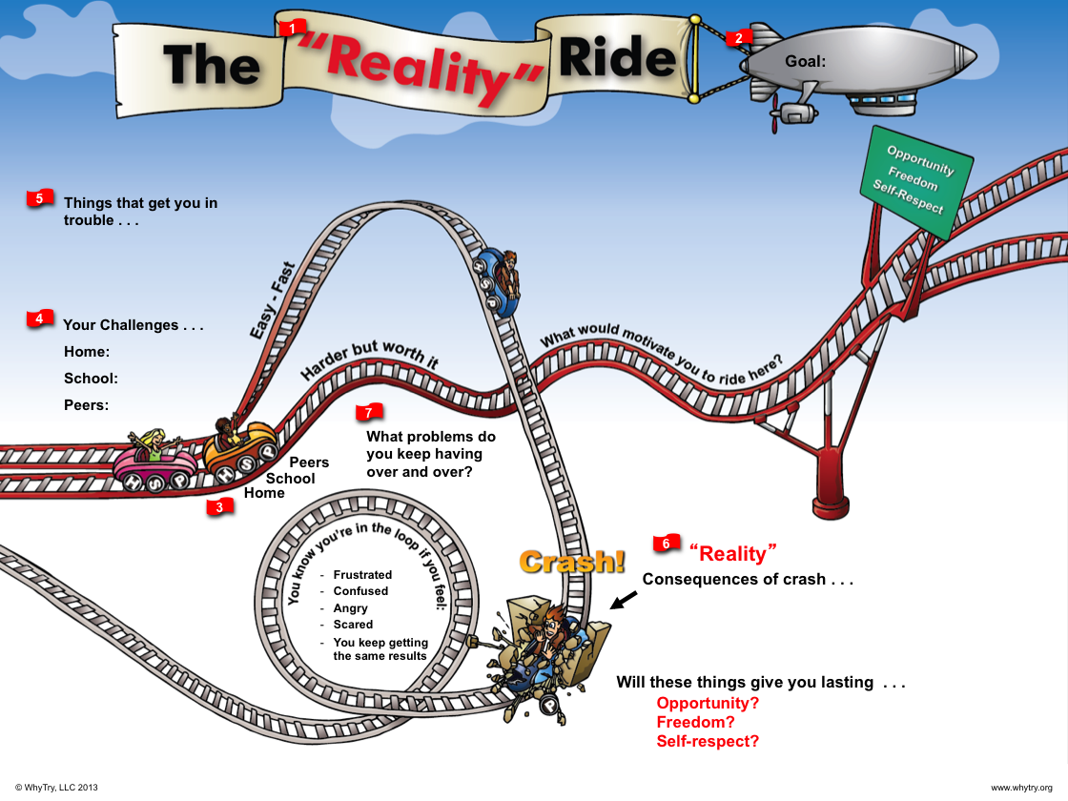

Slide 12


Slide 13


Slide 14
Art Activity
Draw a picture of a roller coaster with one track showing the fast and easy track and another showing the harder but worth it.
Where do you see yourself on the Reality Ride? Mark where you are on the ride with a star or a stick figure of yourself.
On your picture answer the following questions:
Have you ever gotten in trouble for the same thing over and over again?
How have you gotten out of the loop in the past?
List your top 5 strengths

Slide 15

Journal Activity
Whenever we make a choice we have consequences.
Give an example of a choice that has a positive consequence.
Give an example of a choice that has a negative consequence.
What is an example of something that is ‘harder but worth it’?

Slide 16

Game Plan Activity
What opportunities would you like to have in life?
Create a T chart on a paper to create a 1 year, 5 year, and 10 year goal for each section.
Label the sections: Education/Learning, Job/Career, Hobbies/Interests, Friends/Familiy
Write a goal for each section that aligns with each timeframe.
Choose one of those goals and create a game plan to achieve it (game plan=what do you have to do and what do you need to stop doing to achieve it)

Slide 17

Plugging in Activity
Draw or show a copy of the Reality Ride to a parent, guardian or older sibling.
Ask them how the Reality Ride applies to their life.
Have them describe what it means to take the ‘harder but worth it’ track.

