Slide 1
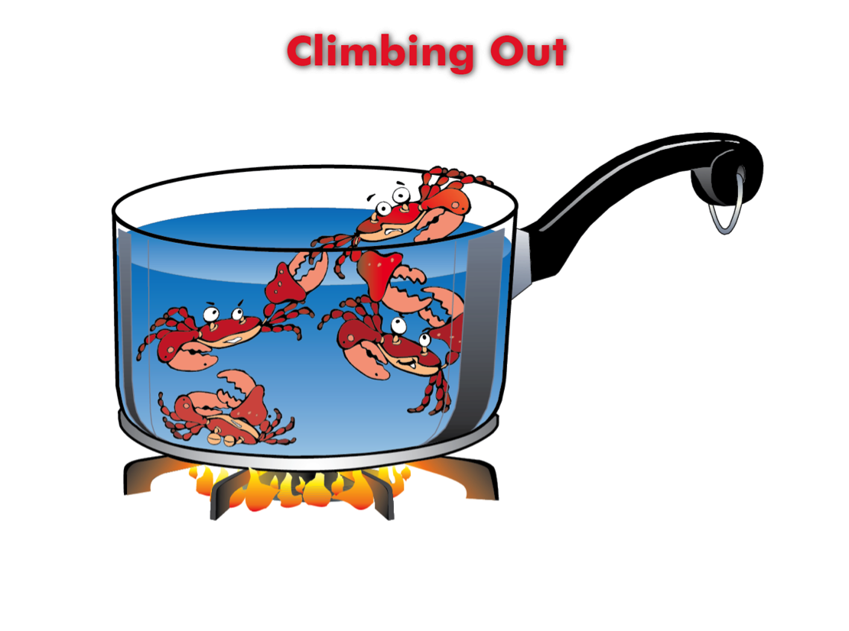
Climbing Out
(Lesson Plan Template)

Slide 2
ATTENTION GETTER
Create your own attention-getter slide to start today’s lesson. This slide may include music, a story, an object lesson, a "Surrendering the One-up" activity, a group poll, or a brief movie clip.

Slide 3
Climbing Out
Complete Metaphor
Animated Metaphor Walkthrough
Music
Learning
Journal
Video

Slide 4
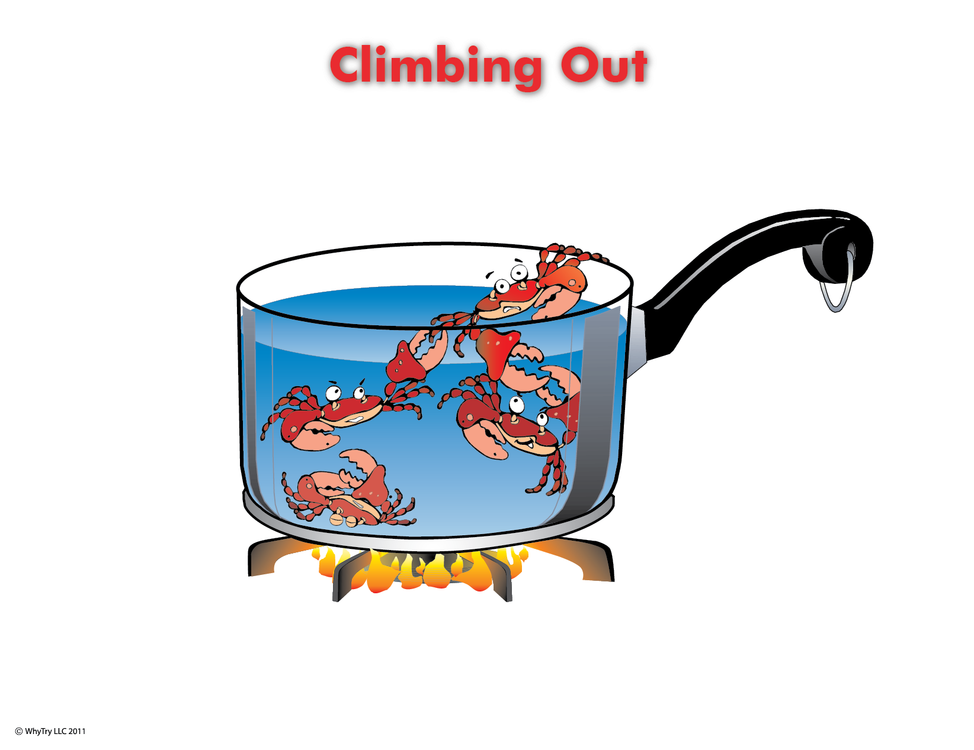
2
What is the “pot” that you are in?
4
How do friends (others) effect you in both positive ways and negative ways?
3
When you get in trouble (or in the pot)
are you keeping others in, or yourself?
How?
5
Who wants to see you climb out? Why?
6
What are the reasons for staying in the pot?
7
What will your future be like if you don’t get out?
9
What will your future be like when you climb out?
1
Why is it difficult for the crabs to climb out of the pot?
8
What are the reasons for getting out of the pot?
10
What are the tools you can use to get out?
Warning: if you try to get out you will be attacked! Why?

Slide 5
2
What is the “pot” that you are in?
4
How do friends (others) effect you in both positive ways and negative ways?
3
When you get in trouble (or in the pot)
are you keeping others in, or yourself?
How?
5
Who wants to see you climb out? Why?
6
What are the reasons for staying in the pot?
7
What will your future be like if you don’t get out?
9
What will your future be like when you climb out?
1
Why is it difficult for the crabs to climb out of the pot?
8
What are the reasons for getting out of the pot?
10
What are the tools you can use to get out?
Warning: if you try to get out you will be attacked! Why?

Slide 6
Music
Create your own music activity slide. This may include a WhyTry music video, a song of your own, or a song a student has shared.

Slide 7
Activity
Create your own learning activity slide. This may include either an object lesson, a group activity, or a group / movement activity. This slide may include instructions /rules for the activity or a relevant visual prompt to introduce the activity.

Slide 8
Journal
Create your own journal activity slide. This slide may include an art activity, observation activity, or game plan exercise from the WhyTry student journal. This slide may contain the actual journal page or a relevant visual prompt to introduce the journal activity.

Slide 9
Video
Create your own video activity slide. This slide may include one of WhyTry’s recommended YouTube clips that you have downloaded and embedded here, or any other relevant video clip reinforcing some aspect of today’s lesson. Videos may be funny, serious, documentary style, etc. This is a good opportunity to differentiate your approach to best meet your student’s needs.

