Slide 1


Welcome To Class!
Have you had fun in this class?

Slide 2
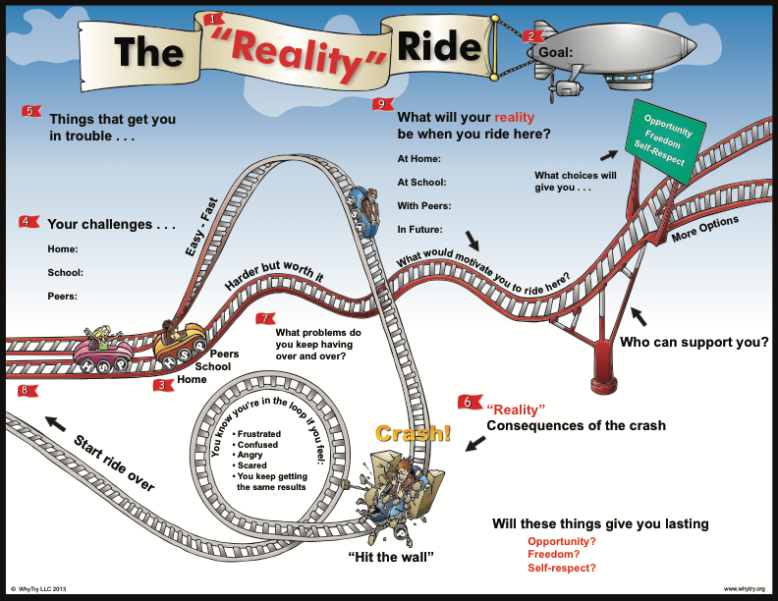

Slide 3
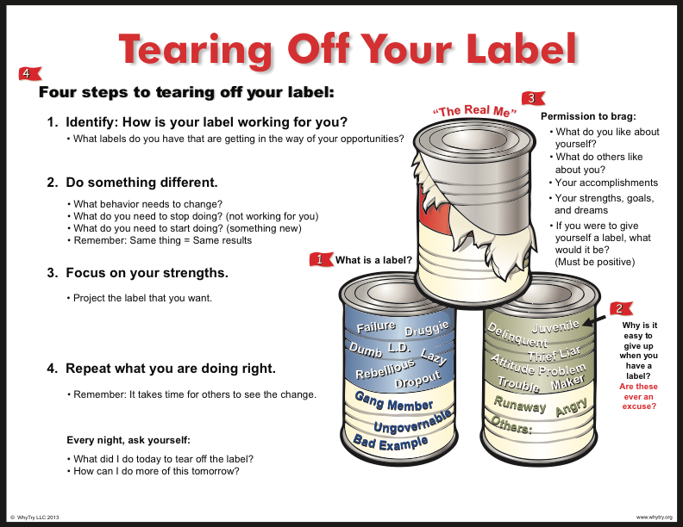

Slide 4


Slide 5
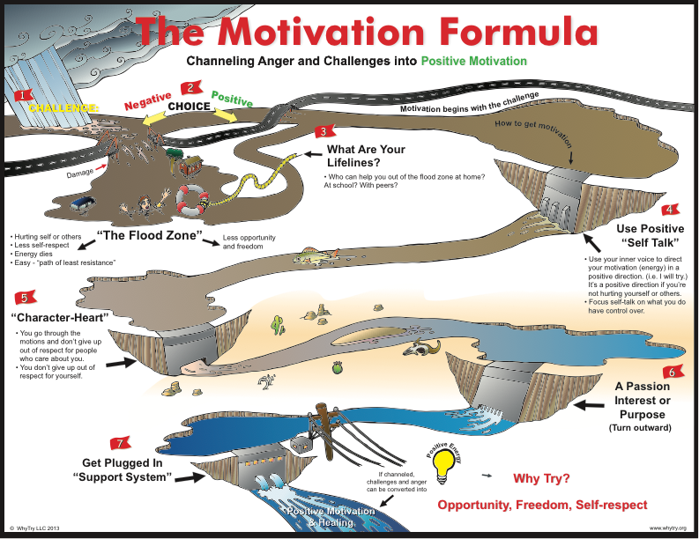

Slide 6
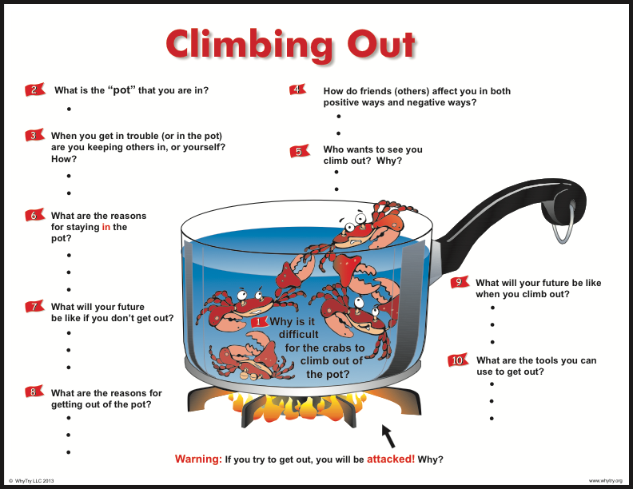

Slide 7
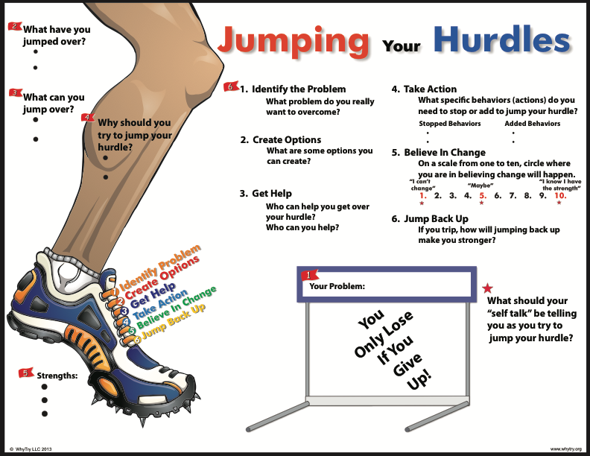

Slide 8
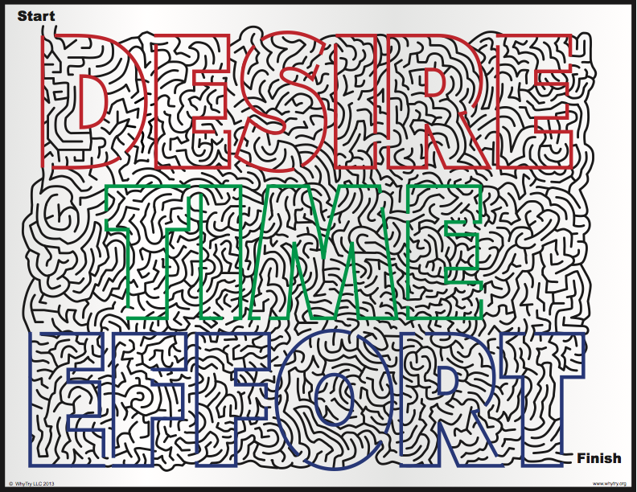

Slide 9


Slide 10


Slide 11
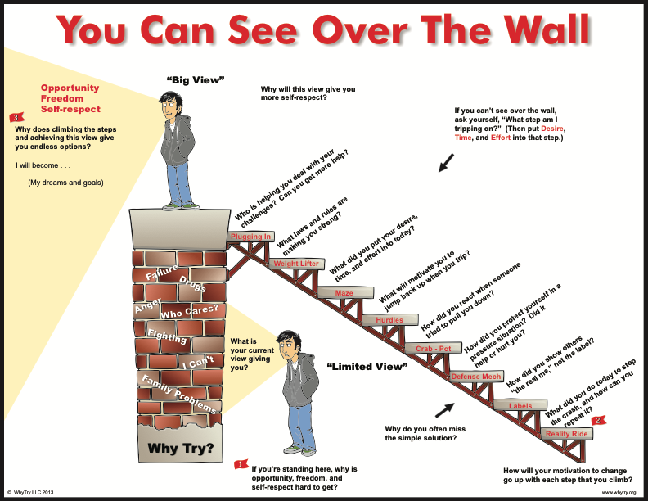

Slide 12

Homework
Answer the question: “Why Try”

Slide 13

Thanks for Coming!

