Slide 1
Welcome To Class!
If you could only watch one T.V. Show for the rest of your life what would it be?

Slide 2
Student Walkthroughs

Slide 3
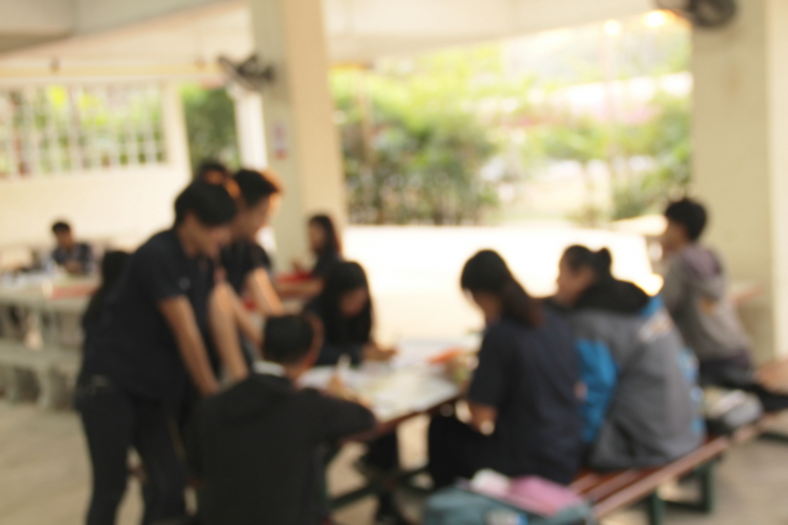
Alternate Activity
What was one of your favorite activities from this semester?

Slide 4
Thanks for Coming!

